Slide 1
Natural Language Processing

Slide 2
Motivation
There are over a trillion pages of information on the Web, almost all of it in natural language.
An agent that wants to do knowledge acquisition needs to understand (at least partially) the ambiguous, messy languages that humans use.
We examine the problem from the point of view of specific information-seeking tasks:
text classification,
information retrieval,
and information extraction.
One common factor in addressing these tasks is the use of language models:
models that predict the probability distribution of language expressions.

Slide 3
LANGUAGE MODELS
Formal languages, such as the programming languages Java or Python, have precisely defined language models.
A language can be defined as a set of strings;
“print(2 + 2)” is a legal program in the language Python,
whereas “2)+(2 print” is not.
Since there are an infinite number of legal programs, they cannot be enumerated; instead they are specified by a set of rules called a grammar.
Formal languages also have rules that define the meaning or semantics of a program; for example, the rules say that the “meaning” of “2 + 2” is 4, and the meaning of “1/0” is that an error is signaled.
Natural languages, such as English or Spanish, cannot be characterized as a definitive set of sentences.
Everyone agrees that “Not to be invited is sad” is a sentence of English, but people disagree on the grammaticality of “To be not invited is sad.”
Therefore, it is more fruitful to define a natural language model as a probability distribution over sentences rather than a definitive set.
That is, rather than asking if a string of words is or is not a member of the set defining the language, we instead ask for P(S = words)—what is the probability that a random sentence would be words.
Natural languages are also ambiguous.
Finally, natural languages are difficult to deal with because they are very large, and constantly changing. Thus, our language models are, at best, an approximation.

Slide 4
N-Gram Models of Language
Use the previous N-1 words in a sequence to predict the next word
Language Model (LM)
unigrams, bigrams, trigrams,…
How do we train these models?
Very large corpora
Corpora are online collections of text and speech

Slide 5
N-gram word models
Now we turn to n-gram models over words rather than characters.
All the same mechanism applies equally to word and character models.
The main difference is that the vocabulary (the set of symbols that make up the corpus and the model)is larger.
Word n-gram models need to deal with out of vocabulary words.
For example, any string of digits might be replaced with <NUM>, or any email address with <EMAIL>.
Models:
Unigram
Bigram
Trigram

Slide 6
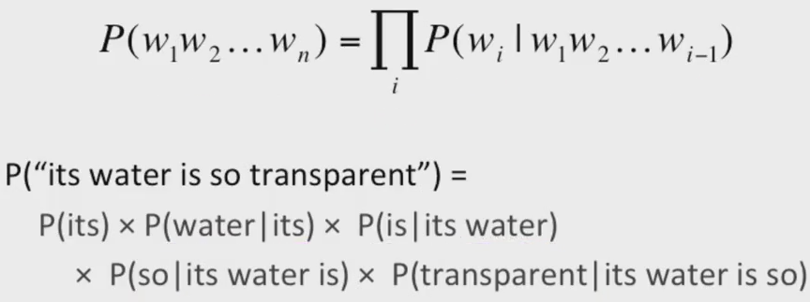
Probabilistic Language Model
The Chain Rule applied to compute joint probability of words in sentence:

Slide 7
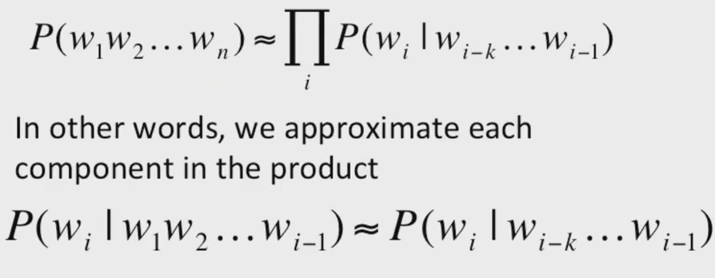
Markov Assumption

Slide 8
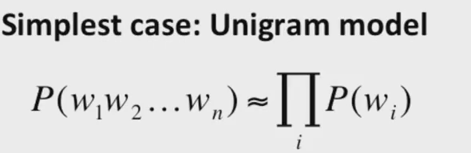
Unigram Model

Slide 9
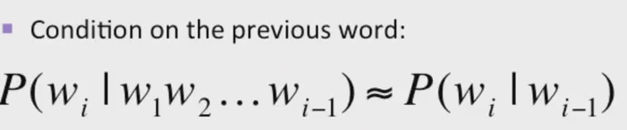
Bigram Model

Slide 10
N-Gram Models
We can extend to trigrams, 4-grams, 5-grams.

Slide 11
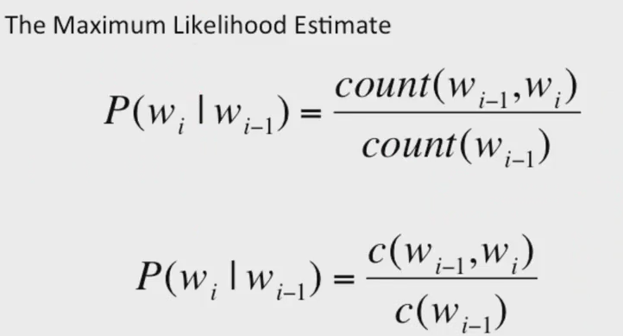
Estimating Bi-Gram Probabilities

Slide 12
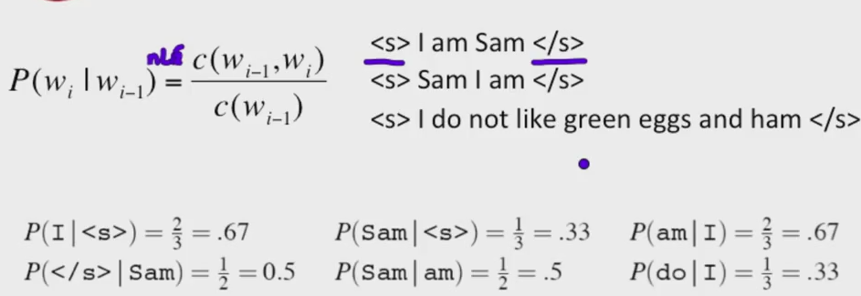
Example

Slide 13
Language Modelling Toolkits
SRILM:
http://www.speech.sri.com/projects/srilm/
Google n-gram corpus
Google books n-gram corpus

Slide 14
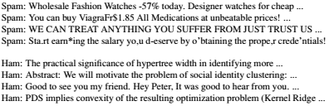
TEXT CLASSIFICATION
Given a text of some kind, decide which of a predefined set of classes it belongs to.
examples of text classification:
sentiment analysis
spam detection (classifying an email message as spam or not-spam).
A training set is readily available: the positive (spam) examples are in my spam folder, the negative (ham) examples are in my inbox. Here is an excerpt:
Then we can classify a new message with an application of Bayes’ rule:

Slide 15
…
In the machine-learning approach we represent the message as a set of feature/value pairs and apply a classification algorithm h to the feature vector X.
We can make the language-modeling and machine-learning approaches compatible by thinking of the n-grams as features.
This is easiest to see with a unigram model.
The features are the words in the vocabulary: “a,” “aardvark,” . . ., and the values are the number of times each word appears in the message.
That makes the feature vector large and sparse. If there are 100,000 words in the language model, then the feature vector has length 100,000, but for a short email message almost all the features will have count zero.
This unigram representation has been called the BAG OF WORDS bag of words model.
It can be expensive to run algorithms on a very large feature vector, so often a process of feature selection is used to keep only the features that best discriminate between spam and ham.
Once we have chosen a set of features, we can apply any of the supervised learning techniques we have seen; popular ones for text categorization include k-nearest-neighbors, support vector machines, decision trees, naive Bayes, and logistic regression.

Slide 16
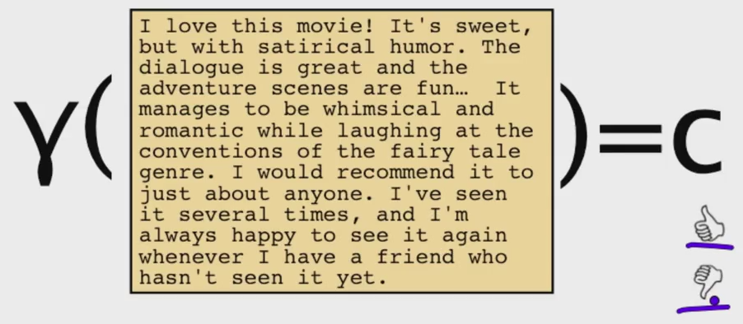
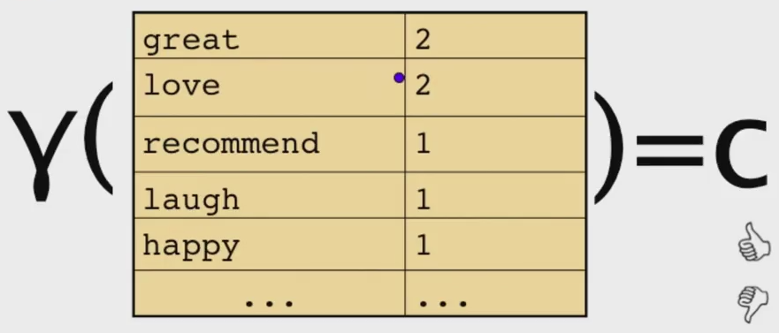
Bag Of words Representation

Slide 17
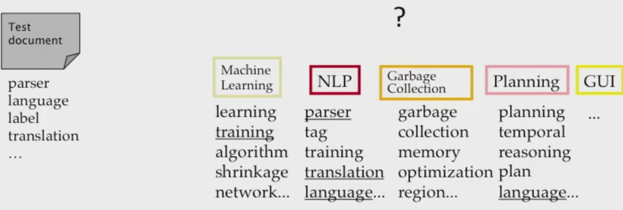
Bag of Words for Document Classifier

Slide 18
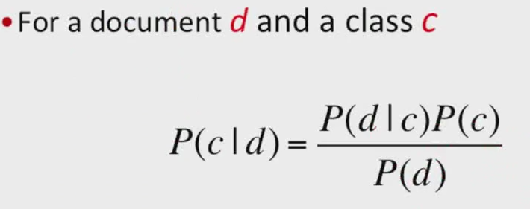
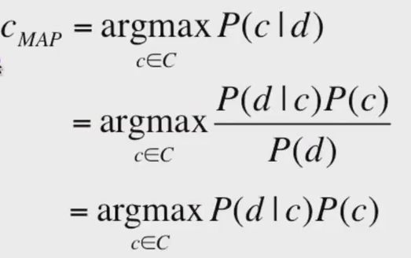
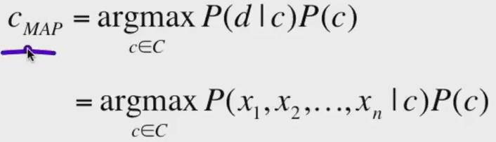
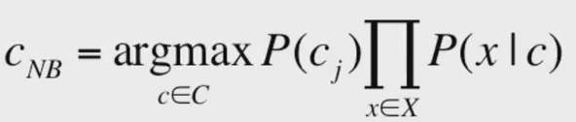
Bayes’ Rule Applied to Documents

Slide 19
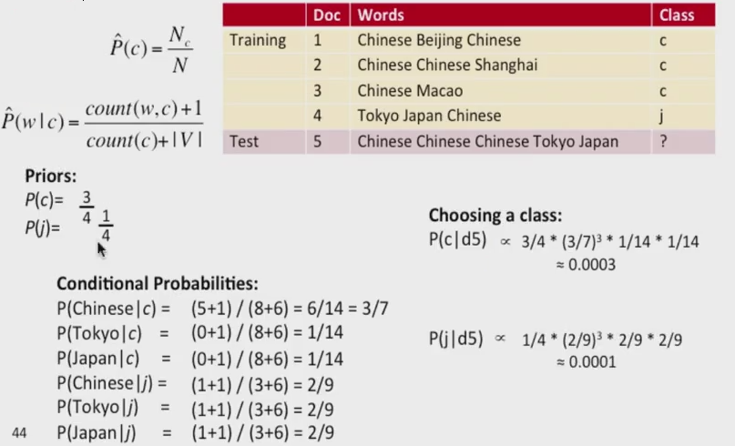
NaiveBayes Example

Slide 20
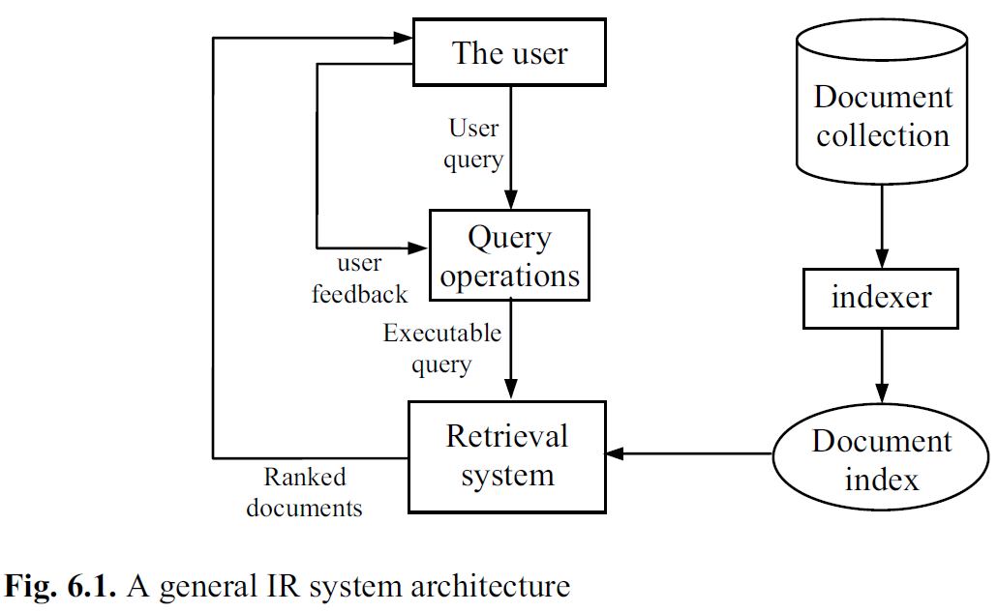
INFORMATION RETRIEVAL
Information retrieval is the task of finding documents that are relevant to a user’s need for information.
The best-known examples of information retrieval systems are search engines on the World Wide Web.

Slide 21
Query Types
Keyword queries:
query ‘Web mining’
‘Web mining’ → ‘Web AND mining’.
Boolean queries:
“data OR Web’,
Phrase queries
“Web mining techniques and applications”
Natural language questions

Slide 22
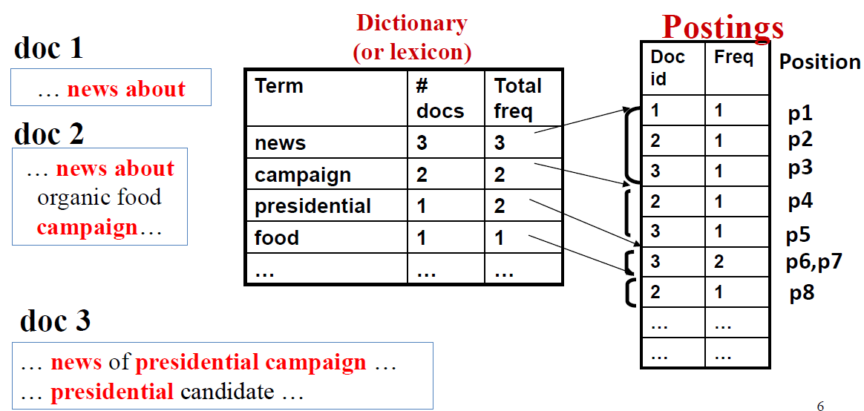
Indexer
An Example

Slide 23
IR Models
Boolean Model
vector space model
language model
probabilistic model
Bu 3 model doküman ve sorguları farklı yollar ile temsil etseler de aynı framework’u kullanırlar.
Her doküman yada sorguyu
“bag” of words yada terms olarak görürler.
Dokümandaki terim sırası yada pozisyonu önemsizdir.
Bir doküman ayrı terimlerin kümesi olarak tanımlanır.
Terim: kelime
Terim bir dil sözlüğündeki kelime olmasından çok ağırlıklandırılmış bir kelimedir.

Slide 24
Retrieval System
D: collection of documents.
V = {t1, t2, ...,t|V|} dokümanlarda geçen tüm terimler kümesi
|V|: terim kümesi büyüklüğü, (V deki terim sayısı)
wij > 0 her bir ti terimini dj ϵ D dokümanı ile eşleştirir.
dj dokümanında yer almayan bir terim için, wij = 0.
Her doküman bir terim vektörü (term vector)ile temsil edilir.
dj = (w1j, w2j, ..., w|V|j),
Her bir wij terim ti ϵ V ve dj ile ilişkilidir ve terimin doküman için önem derecesini verir.
Bu vektör gösterimi ile doküman kümesi basitçe bir relational table (yada matris) olarak gösterilir.
Farklı IR modellerinde, wij farklı şekillerde hesaplanır.

Slide 25
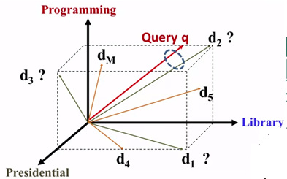
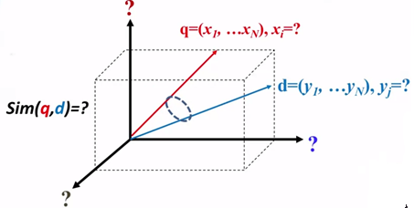
Document Similarity

Slide 26
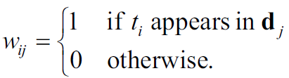
Boolean Model
İlk ve basit information retrieval model
Kullanıcı sorgusu ve dokümanlar arası kesin eşleşme kuralını kullanır
query ve retrieval Boolean cebrine dayanır
Document Representation: Boolean modelde, dokümanlar ve sorgular terimler kümesi olarak temsil edilir. Bu durumda bir terim bir dokümanda geçer yada geçmez.
Boolean modelde bir doküman için vector representation:

Slide 27
Vector Space Model
Bu model en iyi bilinen ve en yaygın olarak kullanılan IR modelidir.
Document Representation:
Bu modelde bir doküman ağırlık vektörü olarak temsil edilir.
Her terimin ağırlıkları TF veya TF-IDF şemasının değişik versiyonları ile hesaplanır.
Dj dokümanındaki terim ti ‘nin ağırlığı wij {0, 1} aralığındadır.

Slide 28
Document Representation
Term Frequency (TF) Scheme: dj dokümanındaki ti teriminin ağırlığı terimin dokümanda kaç kere geçtiğinin sayısıdır.( denoted by fij).
Dezavantaj: Terimler bu şekilde modele dahil edilirse ayırt edici olmayabilir.

Slide 29


Document Representation
TF-IDF Scheme:
TF: term frequency
IDF: inverse document frequency.
N: toplam doküman sayısı
dfi: ti teriminin en az 1 kere geçtiği doküman sayısı
fij: ti teriminin dj dokümanındaki frekansı
normalized term frequency (tfij) (ti teriminin dj dokümanındaki):
ti teriminin inverse document frequency (idfi) değeri:

Slide 30

Document Representation
Eğer bir terim çok sayıda dokümanda görülürse, bu terim yüksek olasılıkla çok önemli değildir yada ayırt edici değildir.
En son TF-IDF terim ağırlığı şu şekilde hesaplanır:

Slide 31
Document Retrieval and Relevance Ranking
Bir dokümanın gelen bir sorguya uygun olup olmadığının binary kararını vermek zor bir işlemdir.
Boolean modelin tersine, vector space model bu şekilde bir karar vermez. Dokümanları onların sorguya uygunluk derecelerine göre sıralar.
Bunun bir yolu q sorgusunun dj dokümanına olan benzerliğinin hesaplanmasıdır.
En iyi bilinen benzerlik ölçümü: cosine similarity

Slide 32
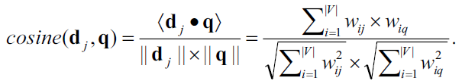
Document Retrieval and Relevance Ranking
cosine similarity: sorgu vektörü q ve doküman vektörü dj arasındaki açının kosinüs değeri,
Ranking işlemi dokümanların benzerlik derecelerine göre yapılır.

Slide 33

IR system evaluation
Imagine that an IR system has returned a result set for a single query, for which we know which documents are and are not relevant, out of a corpus of 100 documents.
Precision measures the proportion of documents in the result set that are actually relevant. In our example, the precision is 30/(30 + 10)= .75.
Recall measures the proportion of all the relevant documents in the collection that are in the result set. In our example, recall is 30/(30 + 20)= .60.
A summary of both measures is the F1 score, a single number that is the harmonic mean of precision and recall, 2P R/(P + R). In a very large document collection, such as the World Wide Web, recall is difficult to compute, because there is no easy way to examine every page on the Web for relevance. All we can do is either estimate recall by sampling or ignore recall completely and just judge precision.
In the case of a Web search engine, there may be thousands of documents in the result set, so it makes more sense to measure precision for several different sizes, such as “P@10” (precision in the top 10 results) or “P@50,” rather than to estimate precision in the entire result set.

Slide 34

Evaluation Measures
IR ve Web search modellerinde dokümanın ilgili yada ilgisiz olması gibi bir sonuca ulaşılmaz. Bunun yerine dokümanlar arasında ilgiliden ilgisize bir ranking skorlaması yapılır ve kullanıcıya sunulur.
D:doküman veritabanı, toplam doküman sayısı:N, q:kullanıcı sorgusu
Retrieval algoritması öncelikle D’deki tüm dokümanlar için uygunluk (relevance) skorları hesaplar. Ranking vaktörü kurulur:
Vektördeki her doküman için precision ve recall değerleri hesaplayabiliriz.

Slide 35
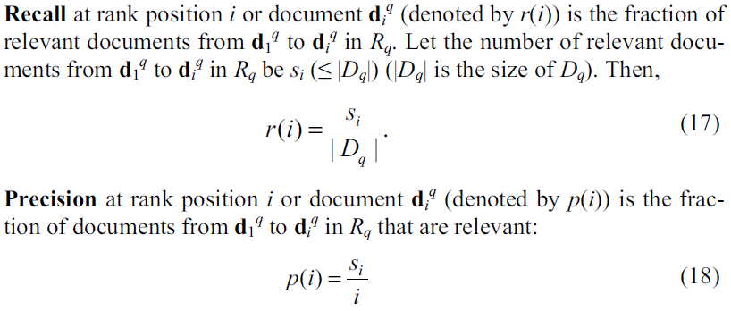
Evaluation Measures

Slide 36
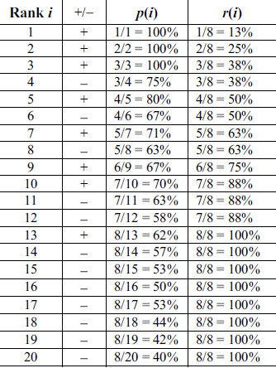
Example
D: 20 doküman
q:sorgu, biliyoruz ki 8 doküman q sorgusu ile uyumlu (relevant)
Bir retrieval algoritması sıralamayı(ranking) çıkarır.
1: highest rank, 20: lowest rank.
“+” :relevant document
“-”: irrelevant document
Kolon 3: precision (p(i))
Kolon 4: recall (r(i)) değerlerini verir.

Slide 37


Evaluation Measures
Average Precision: Sometimes we want a single precision to compare different retrieval algorithms on a query q. An average precision (pavg) can be computed based on the precision at each relevant document in the ranking,

Slide 38
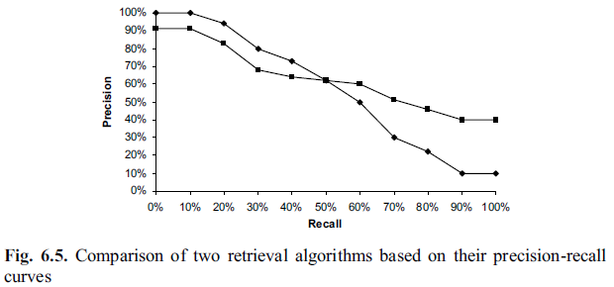
Evaluation Measures
Comparing Different Algorithms: farklı algoritmalara ait sonuçları karşılaştırmak için precision ve recall eğrilerini aynı figürde göstermek iyi bir yoldur

Slide 39

Evaluation Measures
Rank Precision: Örneğin bir Web arama motoru için genellikle top 5, 10, 15, 20, 25 ve 30 adet dönen sayfa için precision değeri hesaplanır. Önceki örneğe göre: p(5) = 80%, p(10) = 70%, p(15) = 53%, ve p(20) = 40%.
Search ranking i değerlerindirmek için precision tek ölçüt değildir. Top ranked sayfaların niteliği de çok önemlidir.
F-score: bir diğer sık kullanılan ölçüttür. Her i rank pozisyonuna ait F-score değerini hesaplayabiliriz.
F-score: precision ve recall değerlerinin harmonik ortalamasıdır.

Slide 40
Text Pre-Processing
Dokümanlar IR sistemlerinde kullanılmadan önce bazı ön işleme adımları gereklidir.
Text dokümanlar için bu önişleme adımları:
stopword removal,
stemming,
and handling of digits, hyphens, punctuations, and cases of letters.
Web sayfaları için, ek işlemler
HTML tag removal
and identification of main content blocks also require careful considerations

Slide 41
Stopword Removal
Tanımlamalar, edatlar, bağlaçlar, zamirler
İngilizcedeki stop words:
a, about, an, are, as, at, be, by, for, from, how, in, is, of, on, or, that, the, these, this, to, was, what, when, where, who, will, with
Türkçedeki etkisiz kelimeler:
Acaba, ama, artık, ancak, aslında, bana, bazen, belki, ben, beni, benim, beş, bile, çoğu, çok, çünkü, daha, de, da, değil, diye, dokuz, dolayı…
https://archive.is/o/LAsMS/http://nlp.ceng.fatih.edu.tr/tr/?p=31
Bu kelimeler dokümanlar indekslenmeden ve depolanmadan çıkarılmalıdır.
Sorgu cümlesindekiler de çıkarılmalıdır.

Slide 42
Stemming
A stem is the portion of a word that is left after removing its prefixes and suffixes.
For example, “computer”, “computing”, and “compute” are reduced to “comput”. walks”, “walking” and “walker” are reduced to “walk”.
Stemming enables different variations of the word to be considered in retrieval, which improves the recall.
Stemming can hurt precision because many irrelevant documents may be considered relevant.
There are several stemming algorithms, also known as stemmers.
In English, the most popular stemmer is perhaps the Martin Porter's stemming algorithm, which uses a set of rules for stemming.

Slide 43
Web Page Pre-Processing
Identifying different text fields: In HTML, there are different text fields,
title, metadata, and body.
Identifying them allows the retrieval system to treat terms in different fields differently.
For example, in search engines terms that appear in the title field of a page are regarded as more important than terms that appear in other fields and are assigned higher weights because the title is usually a concise description of the page.
In the body text, those emphasized terms (e.g., under header tags <h1>, <h2>, …, bold tag <b>, etc.) are also given higher weights.

Slide 44
Web Page Pre-Processing
Identifying anchor text: Anchor text associated with a hyperlink is treated specially in search engines because the anchor text often represents a more accurate description of the information contained in the page pointed to by its link.
Removing HTML tags: The removal of HTML tags can be dealt with similarly to punctuation.
Identifying main content blocks: A typical Web page, especially a commercial page, contains a large amount of information that is not part of the main content of the page.
For example, it may contain banner ads, navigation bars, copyright notices, etc., which can lead to poor results for search and mining.

Slide 45
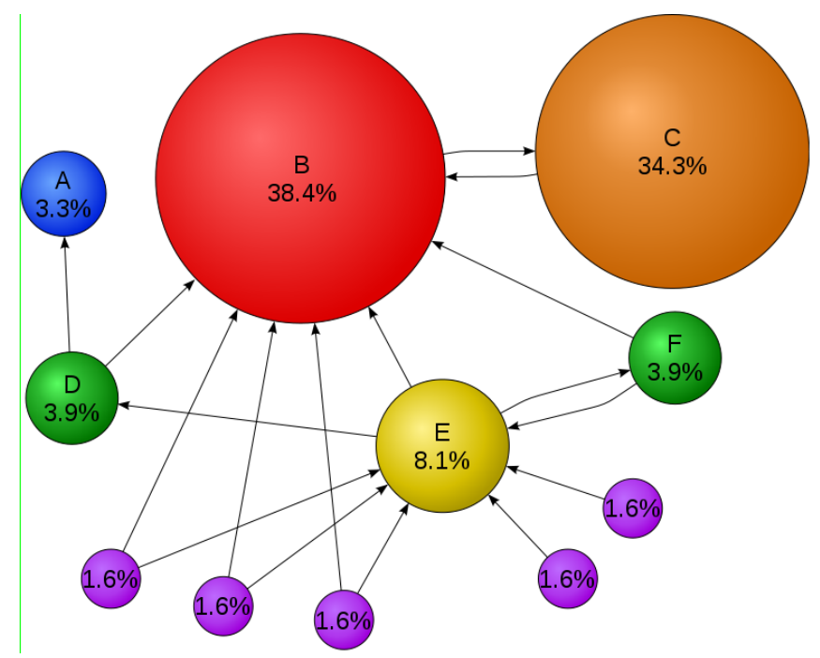
Social Networks: Rank Prestige
Prestij kişiyi gösteren kişilerin sayısıyla ilişkilidir. ● Önemli biri tarafından gösterilen bir kişi, daha az önemli biri tarafından gösterilen kişiden daha prestijlidir.

Slide 46
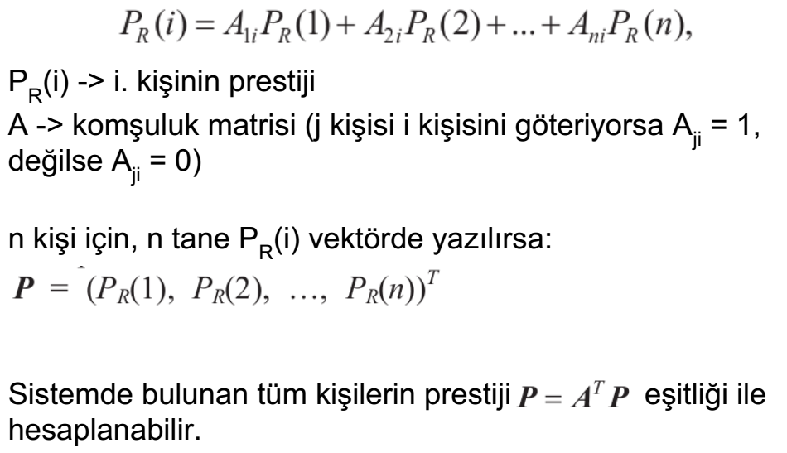
Social Networks: Rank Prestige

Slide 47
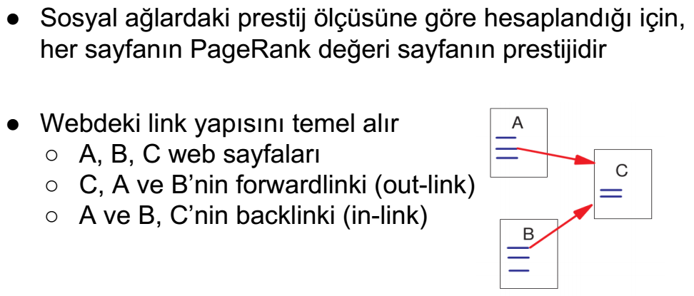
PageRank - Temel Kavramlar

Slide 48
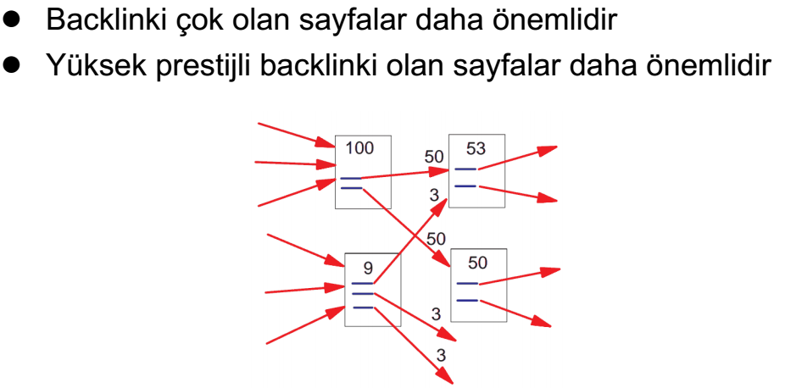
PageRank - Ana Fikir

Slide 49
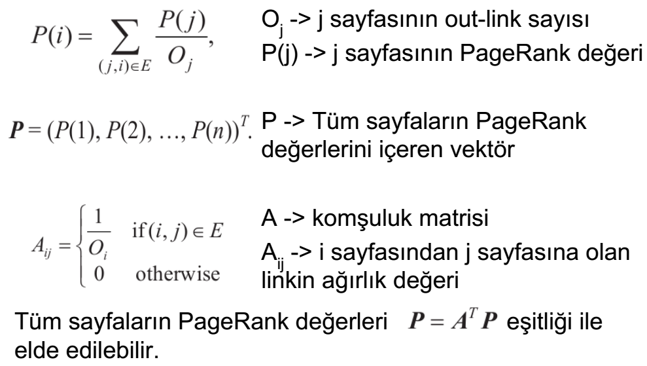
PageRank

Slide 50
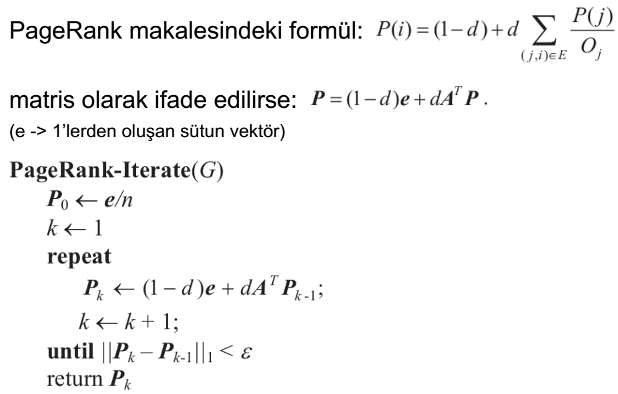
PageRank - iteratif hesaplama

Slide 51
Referanslar
https://class.coursera.org/nlp/
Bing Liu, Web DataMining Exploring Hyperlinks,Contents and Usage Data, Springer-Verlag, Berlin Heidelberg, 2007
Stuart J. Russell and Peter Norvig , Artificial Intelligence A Modern Approach, Prentice Hall

